Slide 1

A whole body model for both glucose and fatty acid metabolism
F.L.P. Sips

Slide 2
Outline
Adipocytes – how to make them important
Lipid metabolism
How can we combine glucose and FA on the whole body level?
The glucose/FA model
Results
Adaptations
Conclusions and future

Slide 3
Adipocytes
Glucose Leptin
Insulin
Adiponectin
NEFA Resistin
Notes:
Adipocytes secrete a variety of compounds that have a role in glucose and energy homeostasis.
They do not simply store fat, they regulate whole body metabolism and fat distribution and play a central role in the development of insulin resistance.

Slide 4
The importance of fatty acid metabolism
... to type II Diabetes - on all scales
  Obesity
  Dyslipidemia; elevated plasma triglycerides and non-esterified fatty acids
  Increase in intracellular FA-derivatives may induce insulin resistance
... to glucose metabolism
  Randle cycle – NEFA inhibit glucose uptake
  NEFA stimulate endogenous glucose production
... to understanding whole body energy metabolism
  More energy passes through FA metabolism than through glucose metabolism
... to a variety of organs
  Liver
  Intestines
  Adipose tissue
  Skeletal muscle
... after a meal

Slide 5
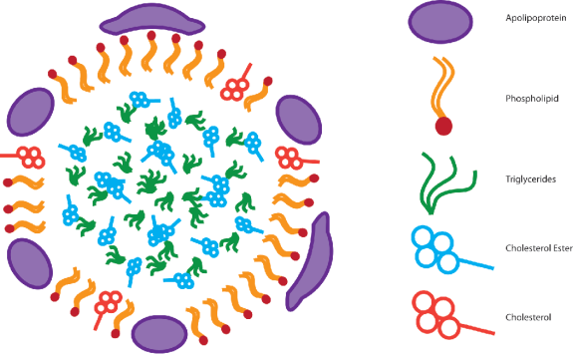
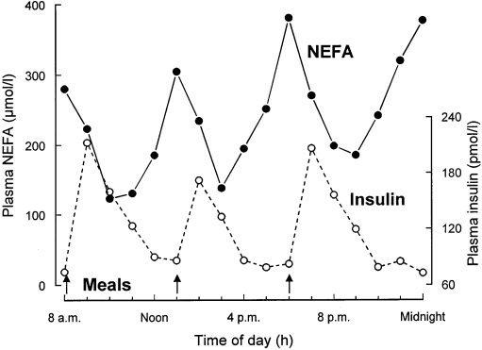
Differences between glucose and lipid metabolism
Triglycerides for transport or storage, fatty acids for use
Insoluble in water : lipoproteins
  Endogenous lipoproteins – VLDL
  Exogenous lipoproteins - Chylomicrons
Highly regulated but with large variations in fluxes and concentrations
  Insulin, glucose, growth hormone, etc.

Slide 6
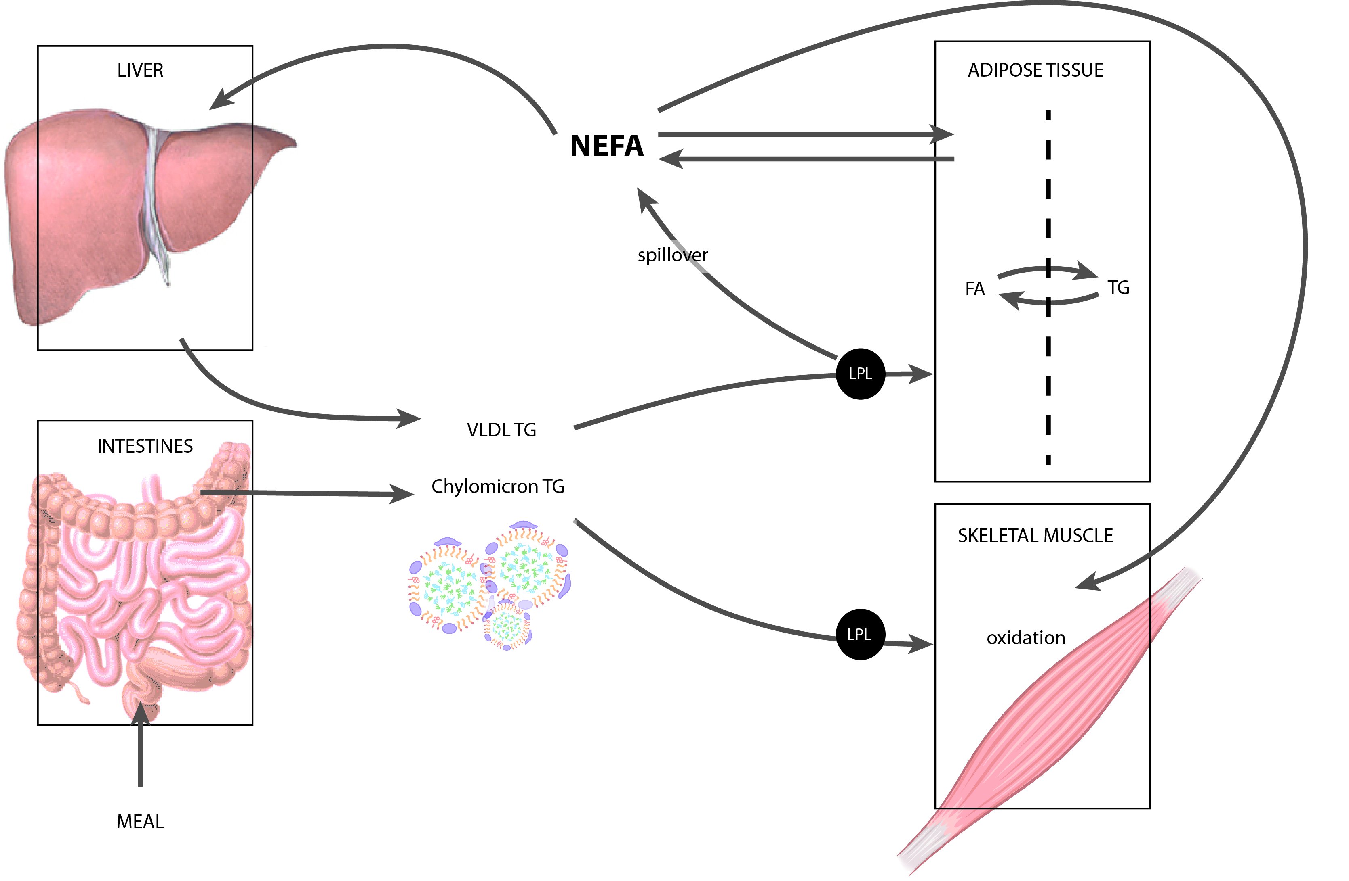
Lipid metabolism

Slide 7
Can the glucose/insulin meal response model (Dalla Man et al.) be expanded with the response of non-esterified fatty acids?

Slide 8
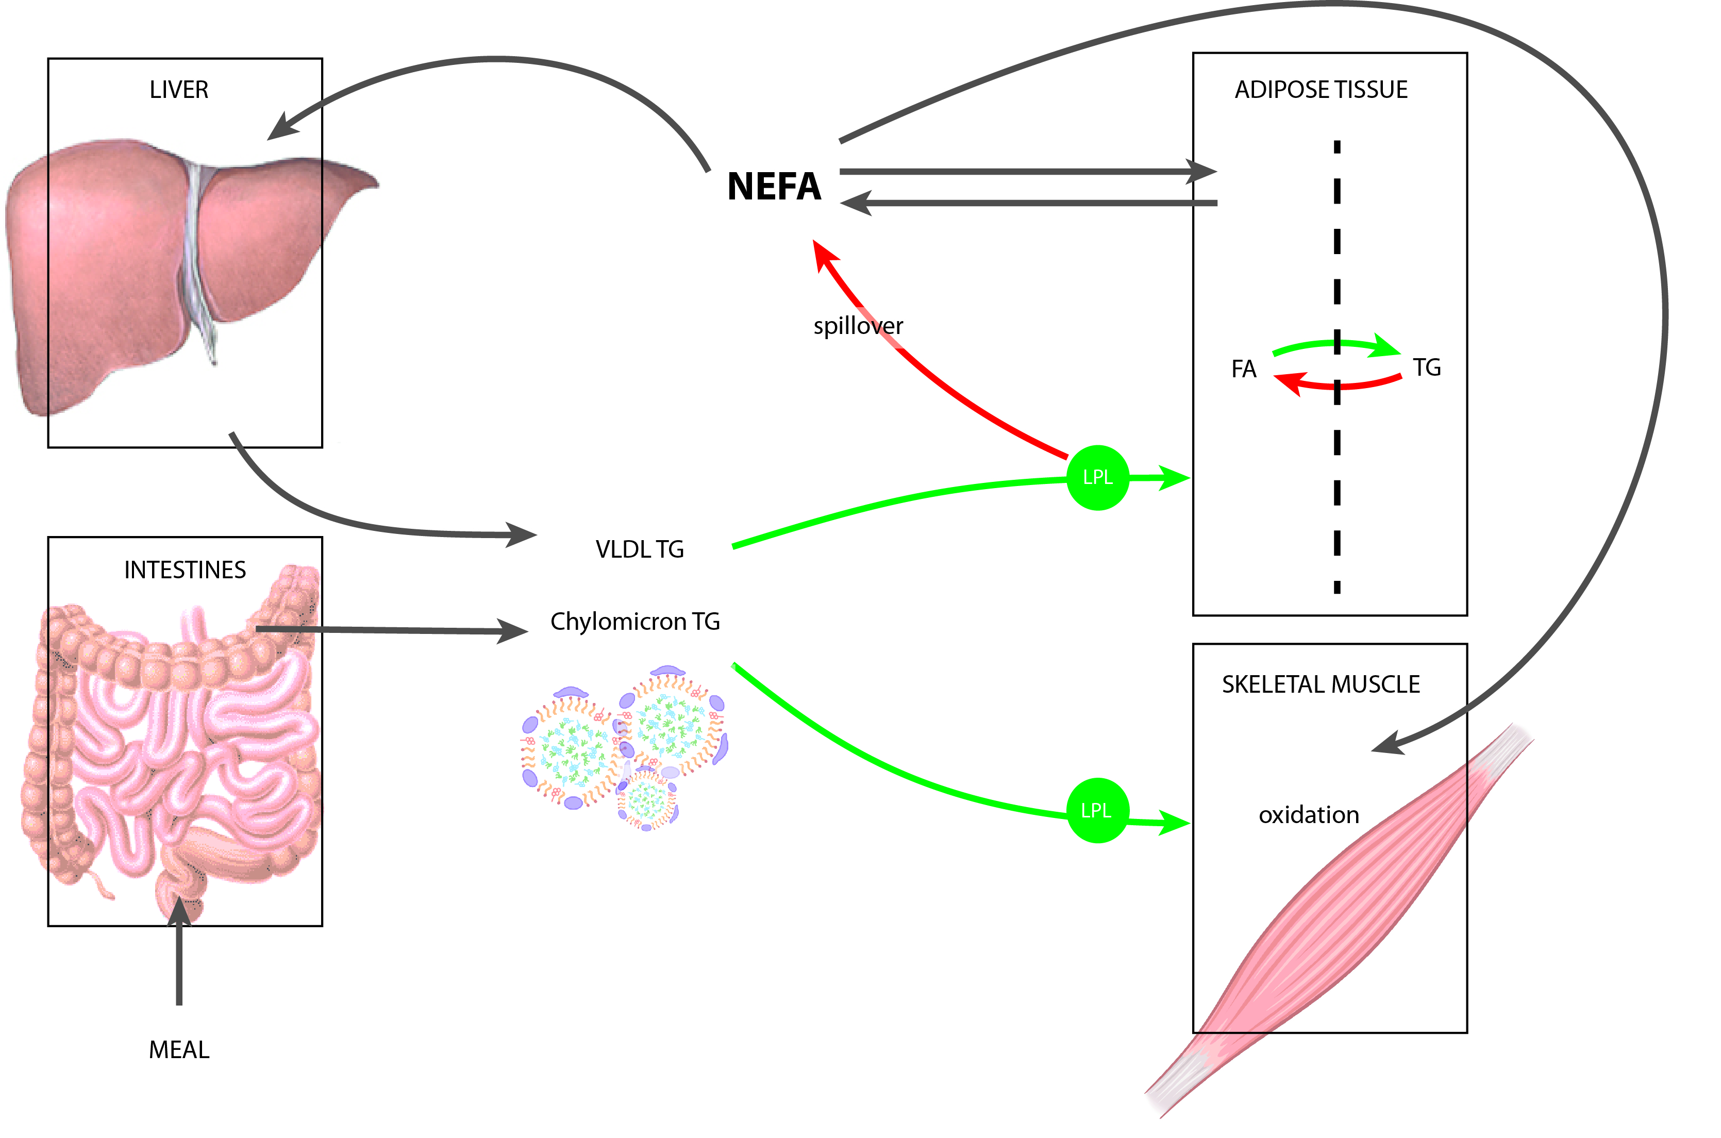
Lipid metabolism
Notes:
Show which red arrow is also regulated by glucose

Slide 9
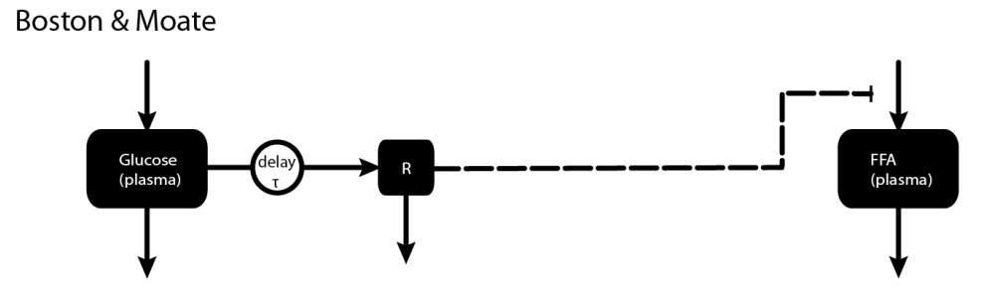
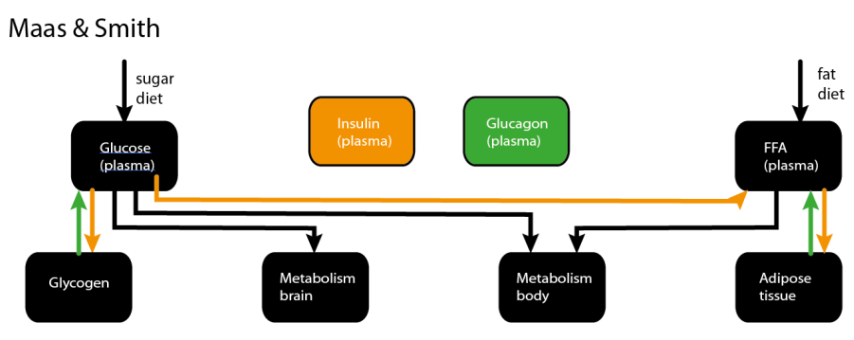
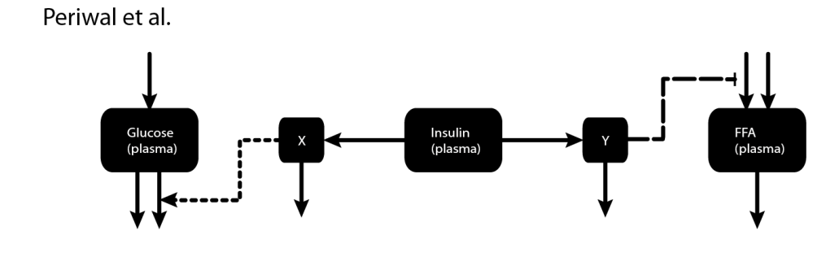
NEFA models in literature
NEFA concentrations depend only on glucose, with a delay
Insulin and glucagon regulate storage and metabolism of glucose and NEFA.
Delayed insulin regulates FA release and glucose uptake

Slide 10
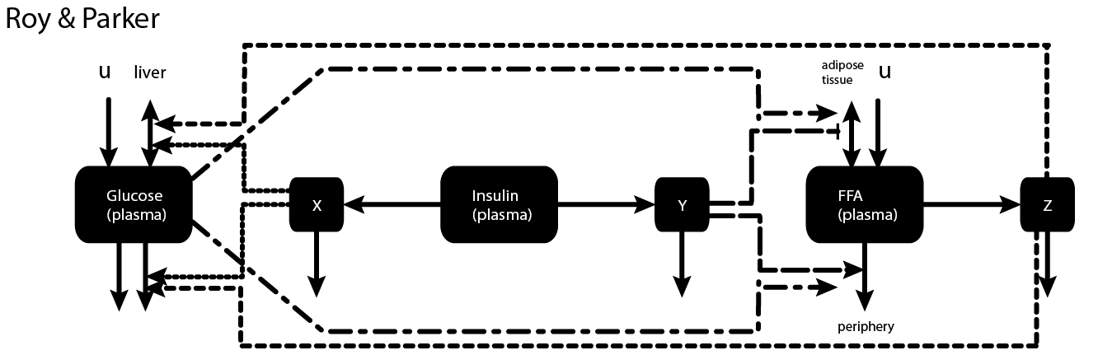
Roy & Parker (2006) model
Regulation by insulin and the Randle cycle
  Insulin regulates glucose metabolism and NEFA uptake and release
  Glucose regulates NEFA metabolism
  NEFA regulate glucose metabolism
Parametrized on dynamic data of different types
  IVGTT, hyperinsulemic euglycemic clamp, lipid infusion
Phemenological

Slide 11
Lipid metabolism
Notes:
Show which red arrow is also regulated by glucose

Slide 12

Lipoprotein lipase
Hydrolyzes triglycerides in lipoprotein – releases FA
FA released by LPL into the plasma depend on:
  Lipoproteins in the blood (Triglyceride concentration)
  Insulin concentration
  Spillover
  Michaelis-Menten equation, modulated by insulin
  [K. Jelic; C. E. Hallgreen; M. Colding-Jørgensen. A Model of NEFA Dynamics with Focus on the Postprandial State. Annals of Biomedical Engineering, 2009, Vol. 37, No. 9, 1897-1909]
Notes:
Triglyceride concentration is an input in this model.

Slide 13
The glucose/NEFA model
Endogenous glucose prod.
Renal extraction
Glucose
Insulin-independent uptake
Meal
Insulin-dependent uptake
Insulin
Hepatic degradation
Secretion (β cell)
Peripheral degradation
Adipose tissue release
Adipose tissue storage
NEFA
Oxidation
Lipoprotein lipase release
Hepatic uptake
TG
Adipose tissue uptake

Slide 14
The glucose/NEFA model
Endogenous glucose prod.
Renal extraction
Glucose
Insulin-independent uptake
Meal
Insulin-dependent uptake
Insulin
Hepatic degradation
Secretion (β cell)
Peripheral degradation
Adipose tissue release
Adipose tissue storage
NEFA
Oxidation
Lipoprotein lipase release
Hepatic uptake
TG
Adipose tissue uptake

Slide 15

The glucose/NEFA model
Endogenous glucose production
Insulin-dependent glucose uptake
Z(t) = Non-esterified fatty acid compartment
X(t) = Insulin compartment

Slide 16
The glucose/NEFA model
Dose response data for
    Endogenous glucose production
    Insulin-dependent glucose uptake
    NEFA response to insulin
Separate the response to fat from the response to glucose
    Oral glucose tolerance test
    Oral fat tolerance test
Meal data
Multiple meals
    The response to a second meal will be different from the response to the first

Slide 17
Dose response data
Endogenous glucose production
Insulin-dependent glucose uptake
NEFA response to insulin concentrations
Glucose/insulin, insulin steps TG/ NEFA, insulin steps
Glucose uptake, 6 experiments
Endogenous glucose production
Glucose (mg/dL), insulin (pmol/L)
Triglycerides (µmol/L), NEFA (µmol/L)
Endogenous glucose production
(mg/min/kg)
Glucose uptake
(mg/min/kg)
Time (min)
Time (min)
NEFA (µmol/L)
Experiment

Slide 18
Oral glucose tolerance test (OGTT)
Initial response of NEFA to insulin
Recovery/rise
Oral Glucose Tolerance Test
Glucose (mg/dL) Insulin (pmol/L)
TG (μmol/L) and NEFA (μmol/L)
Time (min)
Time (min)

Slide 19
Oral fat tolerance test (OFTT)
Initial response of NEFA to insulin
Recovery/rise
Oral Fat Tolerance Test
Glucose (mg/dL) Insulin (pmol/L)
TG (μmol/L) and NEFA (μmol/L)
Time (min)
Time (min)

Slide 20
Why doesn’t NEFA rise?
Glucose
  Insulin-dependent glucose uptake
    NEFA inhibit insulin-dependent glucose uptake
    No insulin = no inhibition
Insulin
  Incretin response
    GLP-1 and GIP respond to a meal within minutes
    The insulin response is potentiated by 50-60%
NEFA
  Spillover
    Determined by intracellular reesterification

Slide 21


Insulin-dependent glucose uptake
Fatty acids only inhibit insulin stimulated glucose uptake
Glucose uptake, 6 experiments
Glucose uptake
(mg/min/kg)
Experiment
Notes:
No insulin = No inhibition by NEFA

Slide 22
Insulin-dependent glucose uptake
Fatty acids only inhibit insulin stimulated glucose uptake
Glucose uptake, 6 experiments
Glucose uptake
(mg/min/kg)
Experiment
Notes:
No insulin = No inhibition by NEFA

Slide 23
Insulin-dependent glucose uptake
Fatty acids only inhibit insulin stimulated glucose uptake
Glucose uptake, 6 experiments
Glucose uptake
(mg/min/kg)
Experiment
Notes:
No insulin = No inhibition by NEFA

Slide 24

Incretin hormones
Model incretin effect
  No stimulation at basal value
  Response time of 5-10 minutes
  Rapid de-activation, 2 minutes
50-60 % of both static and dynamic insulin secretion
Notes:
Cons:
No symbiotic cooperation between GLP-1 and GIP
Diabetes- no way to model the diminished release of one whilst keeping the secretion of the other the same
One is secreted less, action unchanged
For the other secretion is unchanged, action diminished
Neurological response to food by GLP-1 is not modeled
The response time of 5 minutes IS shown

Slide 25
Incretin hormones - results
Glucose (mg/dL) Insulin (pmol/L)
TG (μmol/L) and NEFA (μmol/L)
OGTT
Time (min)
Time (min)
OFTT
Glucose (mg/dL) Insulin (pmol/L)
TG (μmol/L) and NEFA (μmol/L)
Time (min)
Time (min)

Slide 26

Spillover
Intracellular reesterification
After a meal, spillover declines
The time course of this is comparable to LPL activation

Slide 27
Spillover - results
Glucose (mg/dL) Insulin (pmol/L)
TG (μmol/L) and NEFA (μmol/L)
OGTT
Time (min)
Time (min)
OFTT
Glucose (mg/dL) Insulin (pmol/L)
TG (μmol/L) and NEFA (μmol/L)
Time (min)
Time (min)

Slide 28
Conclusion
Lipid metabolism is neccesary on the whole body level
Glucose-insulin model can be expanded to contain
  NEFA
  Lipoprotein lipase spillover
Initial response to a meal or a glucose/fat dose could be reproduced
Return to fasting state can be reproduced with
  Incretin hormones
  Spillover, regulated by insulin

Slide 29
The glucose/NEFA
Endogenous glucose prod.
Renal extraction
Glucose
Insulin-independent uptake
Meal
Insulin-dependent uptake
Insulin
Hepatic degradation
Secretion (β cell)
Peripheral degradation
Adipose tissue release
Adipose tissue storage
NEFA
Oxidation
Lipoprotein lipase release
Hepatic uptake
TG
Adipose tissue uptake

Slide 30
Future
Fluxes for the hierarchical model
Incretin effect –
  Oral glucose dose vs. intravenous glucose dose
Meal/ multiple meals
Fat ingestion is modeled to gut content
  Lipoprotein metabolism
Notes:
Parameter estimation

